Slide 1




NEXT GEN EMPLOYABILITY PROGRAM
Creating a future-ready workforce
Team Members
College Name
Student Name : Pathanjali Cinnakonda Janardhanan
Student ID : au814721104038
SRMTRPEC

Slide 2

CAPSTONE PROJECT SHOWCASE
Project Title
Notes Sharing Web Application using Django Framework
Abstract | Problem Statement | Project Overview | Proposed Solution | Technology Used | Modelling & Results | Conclusion

Slide 3
Abstract
Source :

Slide 4
Problem Statement
Source :

Slide 5
Project Overview
Source :

Slide 6
Proposed Solution
.
Source :

Slide 7
Source :

Slide 8
Source :

Slide 9


Technology Used
Front-end
Back-end
Source :

Slide 10
Modelling & Results
Source :

Slide 11
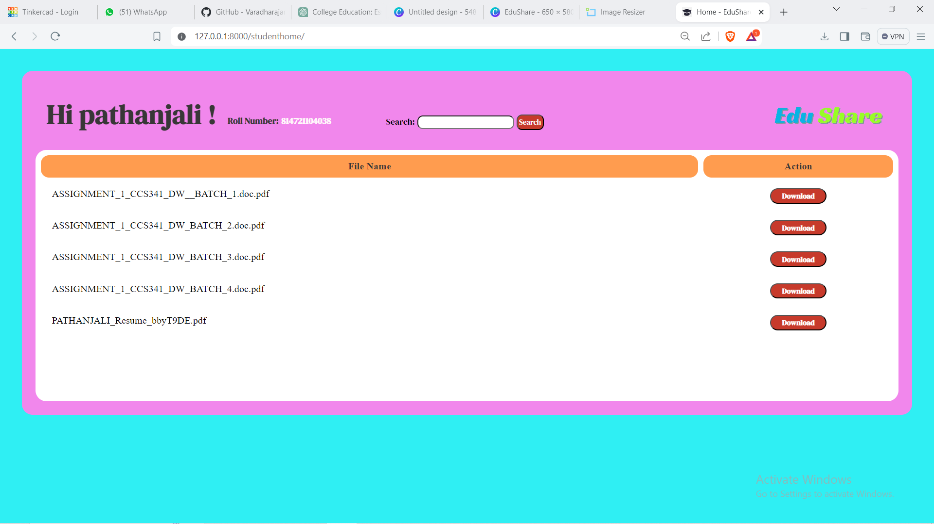
Homepage

Slide 12
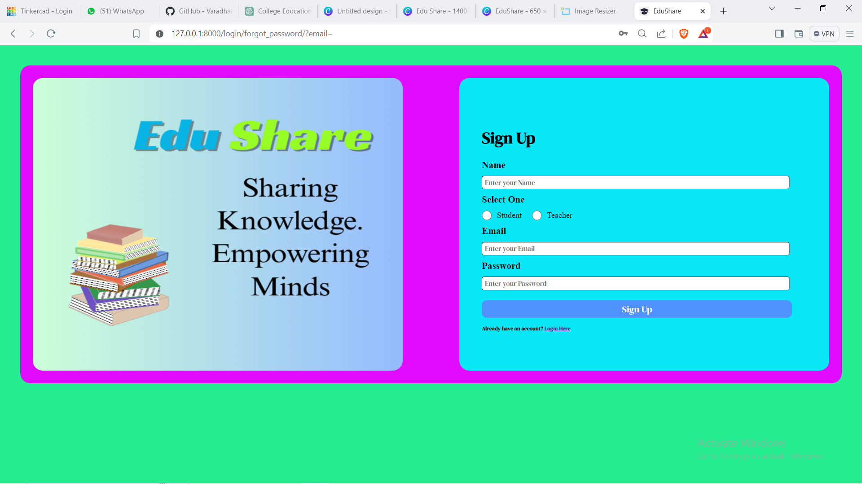
Sign up page

Slide 13
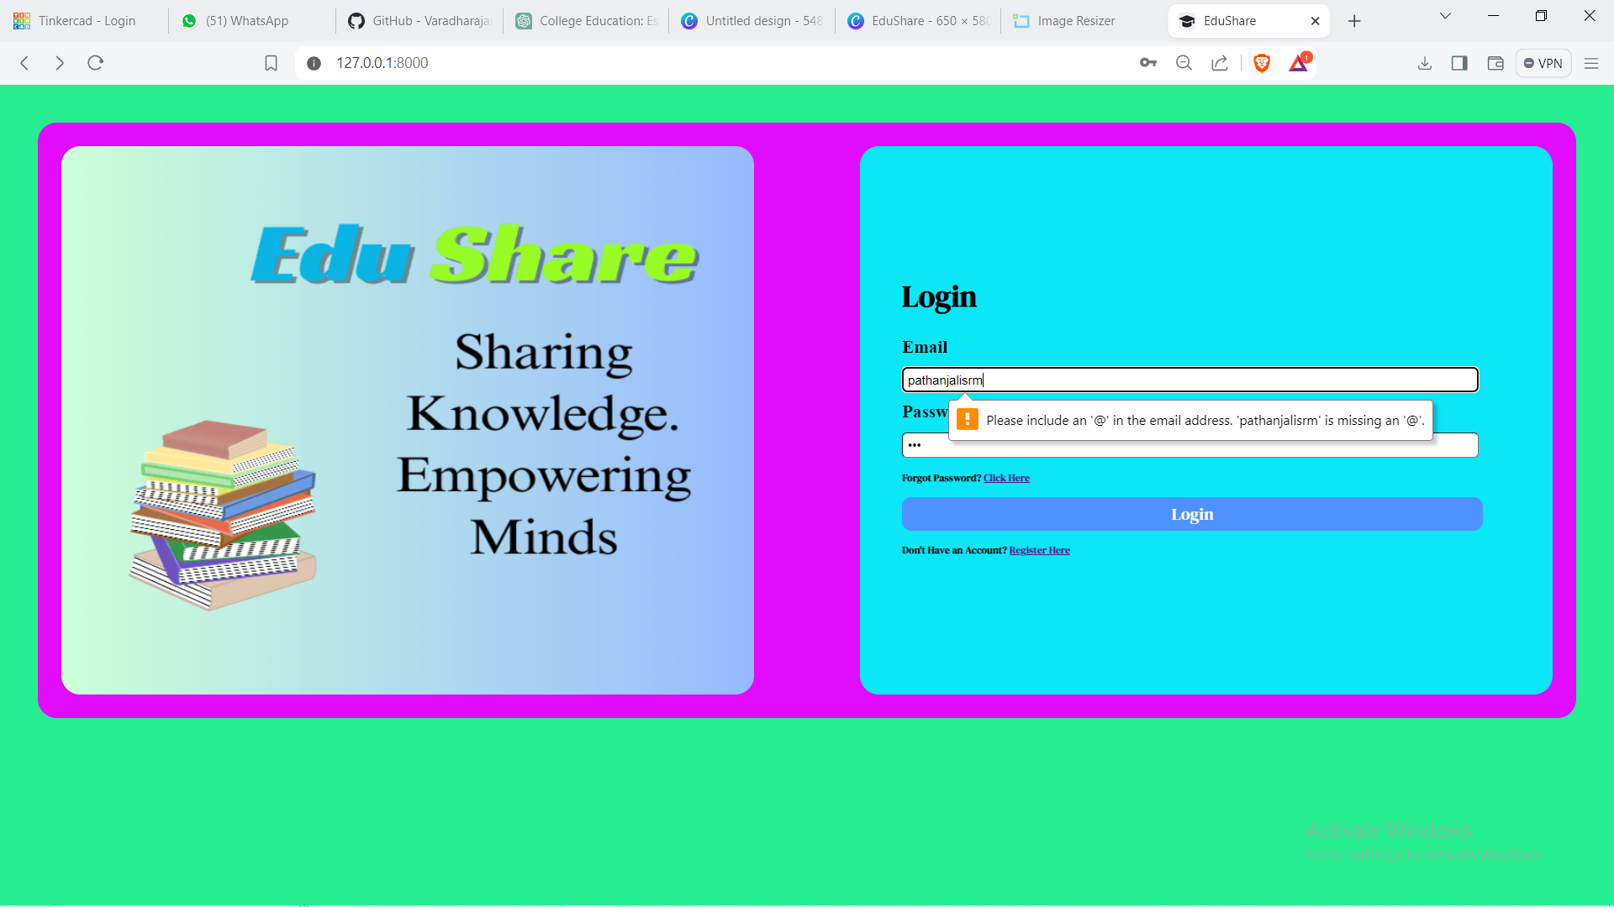
Login page

Slide 14
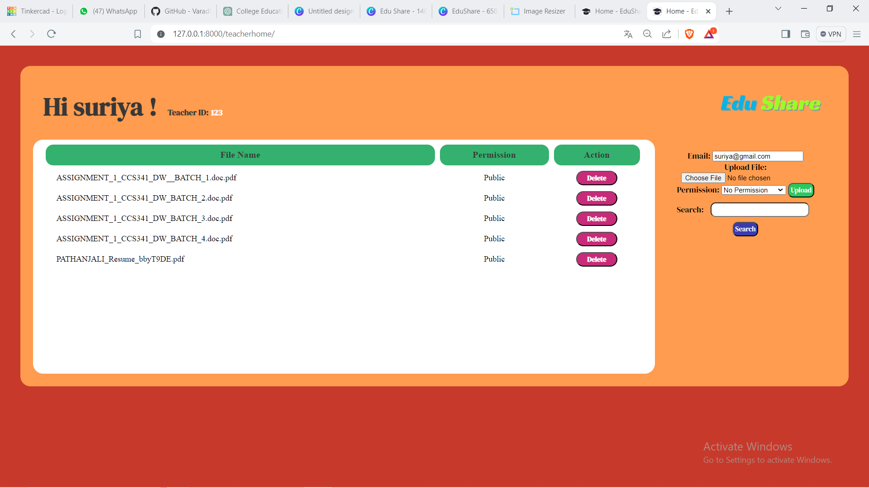
Teachers Home Page

Slide 15
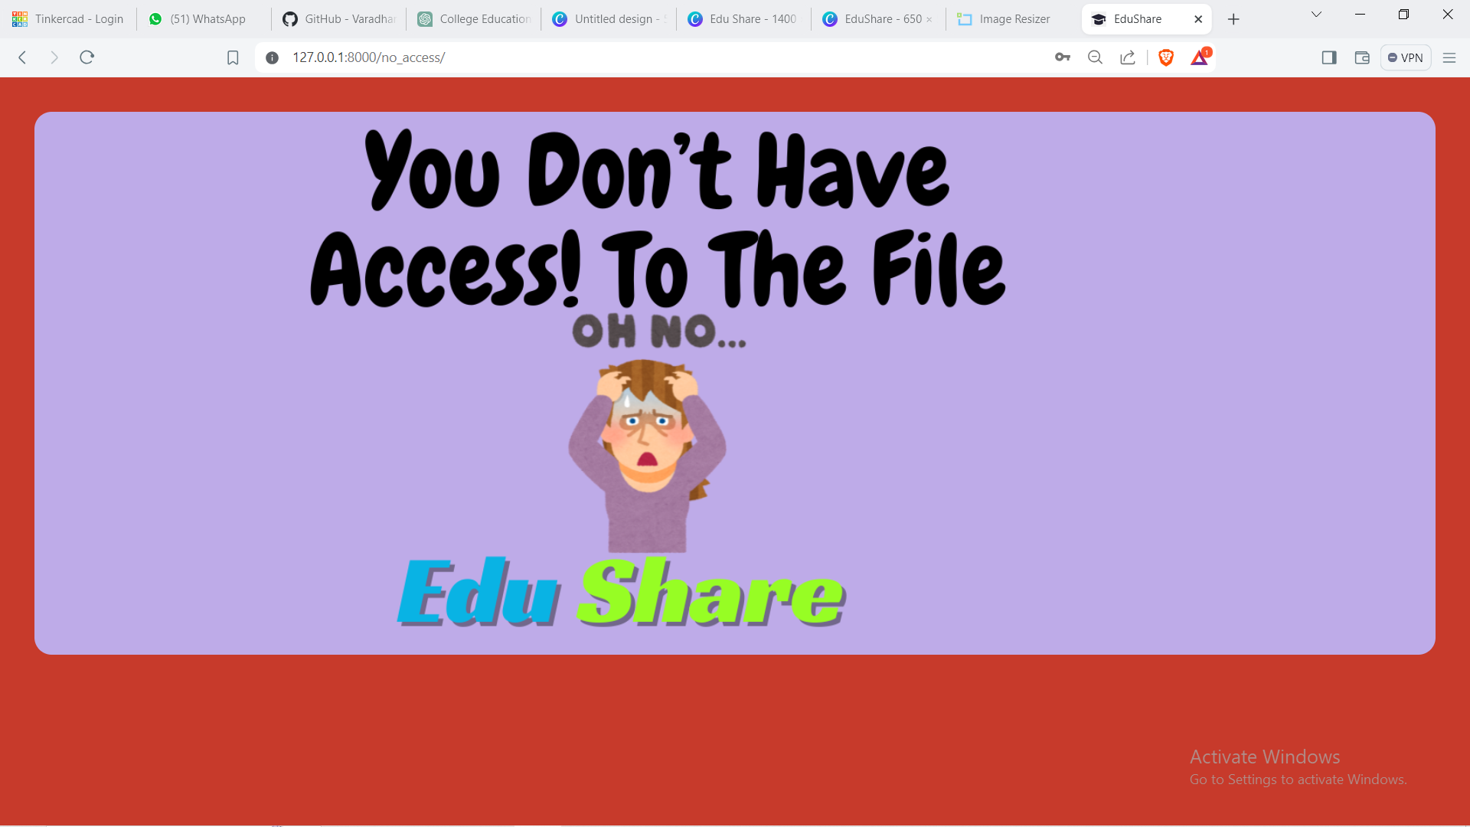
No access

Slide 16
Future Enhancements:

Slide 17
Conclusion
Source :

Slide 18
Thank You!
Notes:
Thank You !!

